Slide 1







Network Intrusion and Security Controls.

Slide 2
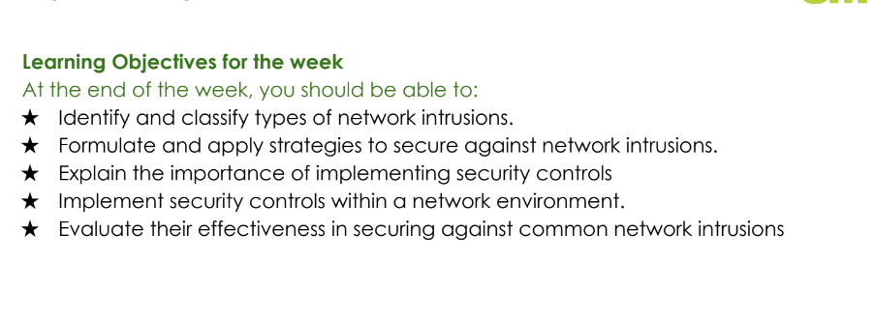




Network Intrusion
Network Intrusions refer to unauthorized attempts to access network resources, data, or services. These can be launched by malicious actors to steal sensitive data, disrupt operations, or compromise systems.
The objective of studying it prevent or minimize unauthorized access and protect the system from intrusions.

Slide 3
Network Intrusion
Network Intrusions refer to unauthorized attempts to access network resources, data, or services. These can be launched by malicious actors to steal sensitive data, disrupt operations, or compromise systems.
The objective of studying it prevent or minimize unauthorized access and protect the system from intrusions.

Slide 4



01
Role of UFW in Network Security
You can enter a subtitle here if you need it

Slide 5
What is UFW?
UFW (Uncomplicated Firewall) is a user-friendly front-end for managing iptables firewall rules in Linux systems.
It simplifies configuring firewall rules to control incoming and outgoing traffic

Slide 6
How UFW Improves Network Security
UFW acts as a barrier between the internal network and external traffic.
It enforces access control policies, allowing only trusted traffic and services while blocking potential threats.

Slide 7
02
UFW’s Security Controls

Slide 8


Installation
- sudo apt update
- sudo apt install ufw -y
- sudo ufw enable
ifconfig

Slide 9
Default deny
By setting the default rule to deny all incoming traffic, UFW ensures that no unsolicited or unwanted traffic can enter the network unless explicitly allowed.
This acts as a baseline defense against unauthorized access

Slide 10

sudo ufw default deny incoming

Slide 11
Allow Only Required Services:
UFW allows configuring specific ports and protocols for services like SSH (22), HTTP (80), and HTTPS (443).
By restricting which services can be accessed, UFW minimizes exposure to attack vectors.

Slide 12
sudo ufw allow ssh
sudo ufw allow http
sudo ufw allow https

Slide 13
Limiting Access with ip-based rules
Restricting Access to Specific IPs or Networks:
UFW can be configured to allow access only from trusted IP addresses or subnets. This limits access to critical services like SSH to known sources, preventing random or malicious login attempts.

Slide 14
NB: This approach adds a layered defense by ensuring that only trusted devices can attempt connections to sensitive services.
sudo ufw allow from <ip> to any port 22

Slide 15
Limiting Access with ip-based rules
Defending Against Port Scanning:
Attackers often use tools like Nmap to scan open ports on a system, identifying vulnerable services.
UFW can block unnecessary ports, leaving only essential services open, and make the network appear stealthy, reducing the risk of exploitation.

Slide 16
NB: This prevents attackers from identifying potential weaknesses in the network, reducing the risk of attacks.
sudo ufw deny 8080

Slide 17
Summary of UFW
Access Control: Restricts access to services based on IPs and ports.
Port Filtering: Reduces exposure by blocking unnecessary services.
ICMP Management: Prevents ping floods and network scans.
Default Deny Policy: Blocks all incoming traffic unless explicitly allowed, ensuring only authorized access.
Ease of Use: UFW simplifies the management of security policies without compromising on robustness.
By implementing UFW, organizations can effectively harden their network perimeter,
protecting it from intrusions and unauthorized access while maintaining control over
legitimate traffic.

Slide 18
Identify a method of implementing security control using the principle of least privilege.
Task 1

Slide 19
Network Analysis
Network analysis is the process of capturing, inspecting, and analysing data packets moving across a network.
This process is useful in:
monitoring performance.
Identifying network vulnerabilities.
Detecting security breaches and intrusions.

Slide 20
01
Role of Wireshark in Network Analysis

Slide 21
What is Wireshark
Wireshark is a free, open-source packet sniffer and analysis tool used to capture and inspect real-time network traffic.
This tool is useful in:
Providing a detailed view of all incoming and outgoing traffic on a network interface.
Allowing filtering of traffic by protocol, IP address, ports, and other criteria.
network troubleshooting, security audits, and forensics.

Slide 22
Wireshark for intrusion detection
Why Use Wireshark for Intrusion Detection?
Security analysts can detect anomalous patterns in network traffic that indicate malicious activities.Identifies attacks such as SYN floods, brute force login attempts, and data exfiltration.

Slide 23
01
Practice
In this practical, we will use Wireshark to capture and analyze ICMP packets generated by a simple ping (using Nmap) to Google.com.

Slide 24
Step 1: Start Wireshark
Open Wireshark on your machine.
From the home screen, double click the appropriate network interface (e.g., Ethernet or Wi-Fi) that connects to the internet.

Slide 25
Step 2: Initiate a Ping to Google.com using Nmap
Open a terminal on your machine.
Run the following Nmap command to send an ICMP echo request (ping) to google.com:
sudo nmap -sn google.com
Where: The -sn option tells Nmap to perform a "ping scan," which sends ICMP echo requests and TCP/ACK packets to check if hosts are up.

Slide 26
Step 3: Capture and Filter ICMP Packets in Wireshark
Stop Packet Capture
Filter for ICMP Packets.
N/B: The Internet Control Message Protocol (ICMP) is a network layer protocol that allows devices to communicate data transmission errors and operational information

Slide 27
Step 4: Analyse the packet Details
Look for ICMP Echo Requests:
Scroll through the filtered results and find packets labelled as Echo (ping) request.
These are the ICMP packets that your machine sent to google.com.You should also see Echo (ping) reply packets if Google.com responded to your request.
Examine Packet Contents:
Click on one of the echo request packets to see the details. You should see:
Source IP: Your machine's IP address.
Destination IP: The IP address for google.com.
Type: ICMP type 8 (Echo Request).

Slide 28
Step 4: Analyse the packet Details
Similarly, examine an echo reply packet to see:
Source IP: The IP address of Google.com.
Destination IP: Your machine’s IP address.
Type: ICMP type 0 (Echo Reply).
This practical demonstrates how to use Wireshark to detect ICMP traffic generated by Nmap's ping scan to a public server like Google.com. Wireshark’s packet filtering and analysis features allow you to easily identify and inspect the ICMP echo requests and replies involved in the ping process.

Slide 29
Thanks!
Do you have any questions?
amosmarvellous48@gmail.com
+234 702 625 4613

